Slide 1
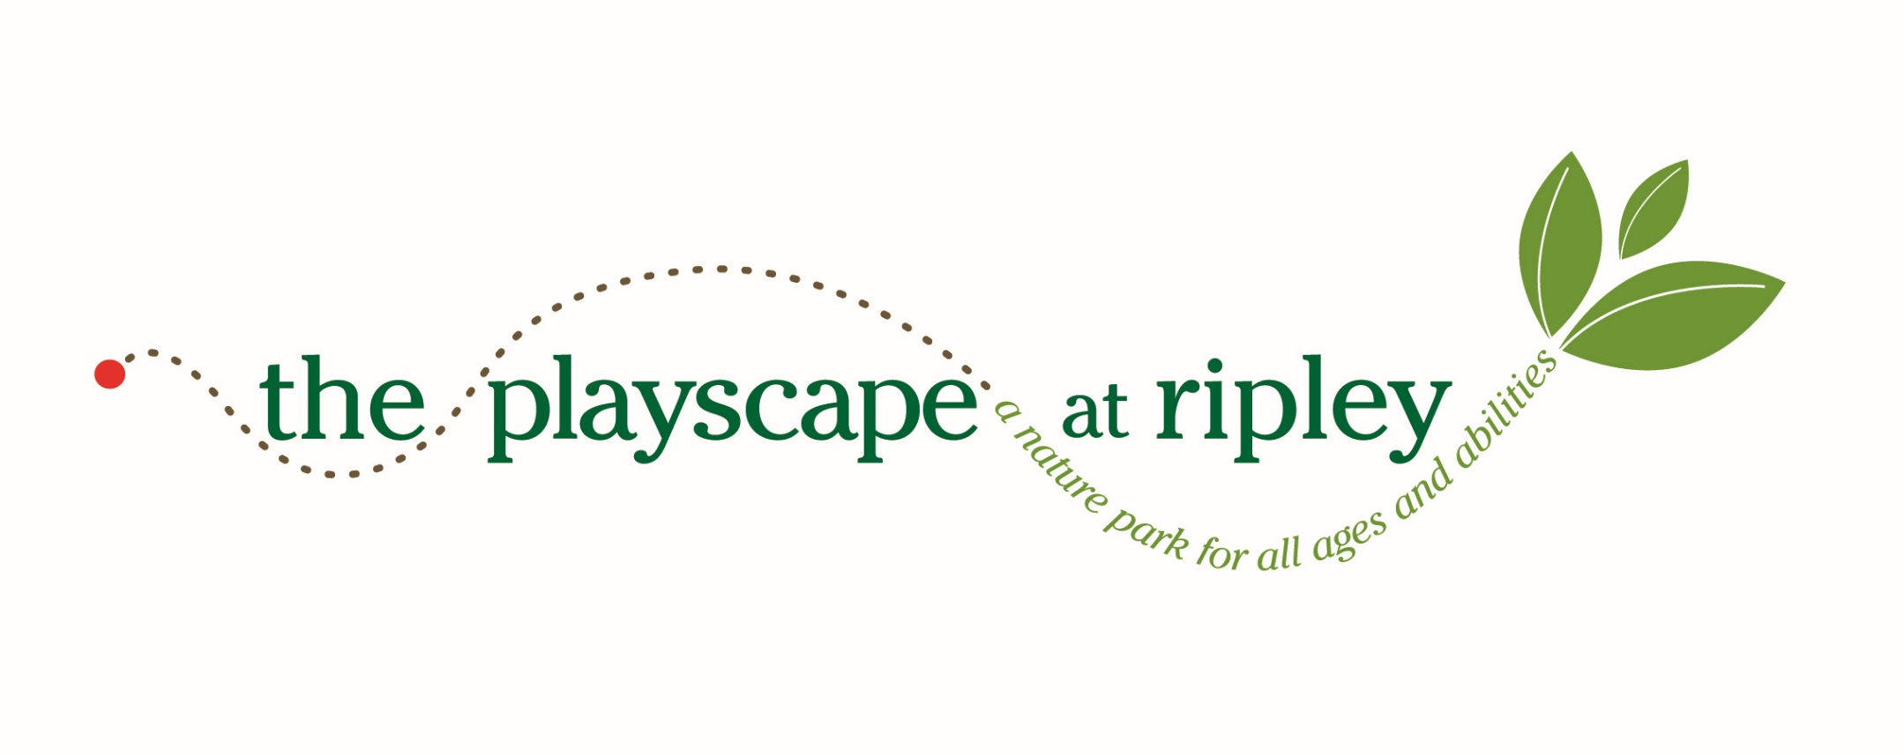
Welcome to

Slide 2

What is the Playscape?
The Playscape at Ripley is a new nature park for all ages and abilities in Concord, Massachusetts. It is a unique, special spot that invites all to play, relax and interact with their environment. The Playscape's design purposefully connects people of all abilities with nature; fosters cognitive, social and emotional growth; and encourages young and old alike to get outside!

Slide 3
Playscape History
2007 report from the American Academy of Pediatrics
  Warned of decline in children’s play in nature
    Structured activities l Technology
  This decline can negatively impact children’s development
  Also means children are missing out on the benefits of outdoor play
In 2008, Concord Children’s Center begins crafting a vision for a nature-based park and playground at Ripley
2011: Community Design Workshop
2011: Friends of the Playscape at Ripley formed
2012: Construction starts

Slide 4
Four Pillars of the
Playscape at Ripley
Nature-Based Play
Ecological Awareness & Stewardship
Universal Accessibility
Gathering the Community

Slide 5
Playscape Features
Accessible stonedust loop path
  Paved with stonedust for use by wheelchairs, walkers, strollers, etc.
  Guide rope for use by visually impaired
Whale Drum: children use natural elements to strike the drum, producing a variety of sounds
Dry Streambed with Bridge: sand and water play are important to children’s development
Sand Play Area and Accessible “Sand Ship”: The sand ship’s raised wide edges make it accessible to children in wheelchairs as well as to people wishing to sit.

Slide 6
Playscape Features
Tree cookie path: encourages jumping and hopping, which are important movements in a child’s physical development.
Nests: child-sized iron nests that children can “build” using natural materials, fostering eye/hand coordination and cooperative play.
Gathering circle: circular space with ship timber benches that can be used for resting, play, or teaching.
Sledding/rolling hill: Low hill is good for rolling by children with sensory disabilities and/or autism spectrum disorder, providing vestibular stimulation.

Slide 7
Playscape Features
Landform benches: embedded benches can be used for seating, climbing, jumping, etc.
Landform with Embedded Slide: the slide’s low profile allows it to be safely used by children with lower upper body stability/strength.
Accessible Picnic Tables: picnic tables have ends that are longer than standard to allow access by people in wheelchairs.

Slide 8
Playscape Fundraising
As of May 4, the Playscape has received almost $300,000 in donations and pledges from individuals, corporations, foundations, and organizations.
  Almost $200,000 in support from the Town of Concord through the CPA.
Construction being done in a phased approach to allow work to be done as funding is secured.

Slide 9
Phase III Features
Inclusive merry-go-round
Child-powered water pump
Community swing
Rubberized surfaces
Benches and game tables

Slide 10

Other Information
The Playscape is a community resource open to the public 24 hours a day
For more information: www.ripleyplayscape.org
Follow us on
Upcoming Discovery Day for the Special Needs Community: 2-4 p.m., Sunday, June 14

